Slide 1
IN609
Operations Engineering 1
PowerShell Controls
Lecture 2-2
Semester 2, 2021

Slide 2
Overview
Last session
Functions
Reminder: string parsing and comparison operators
Control flow
Loops (while, for, counted)
2

Slide 3
(Some) Special Variables
$_ – Contains the current pipeline object, used in script blocks, filters, and the where statement.
$Args – Contains an array of the parameters passed to a function.
$Error – Contains objects for which an error occurred while being processed in a cmdlet.
$Home – Specifies the user’s home directory.
$PsHome – The directory where the Windows PowerShell is installed.
3

Slide 4
Flow Control
Comparison Operators & Logical Operators
Equals, greater than, and, not, etc.
Conditional statements
If, else
Loops
For, foreach, while (do..while, do..until)

Slide 5
Comparison Operators
We cannot use the usual comparison symbols (<,>) → ?
-eq → equals
-ne → not equals
-ge → greater equals
-gt → greater than
-le → less equals
-lt → less than
-in → is contained in collection (“Bicycle” –in get-content file.txt)
-notin → is not contained in collection
-like → similar to (“bicycle” –like “bicyc*”))
-match → matches a given pattern (e.g. “bicycle –match “bic?cle”)
-notMatch → that does not match a given pattern
Not case-sensitive
Use c variants for case-sensitivity (e.g. –cmatch, -clike, -ceq)
Let PowerShell code completion help you!

Slide 6
Logical Operators
-and
-or → and/or (inclusive or)
-xor → either … or… (exclusive or)
-not
For BitWise operations use b-variants of operators (e.g. -band, -bxor)

Slide 7
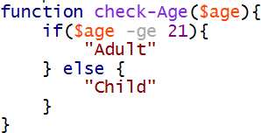
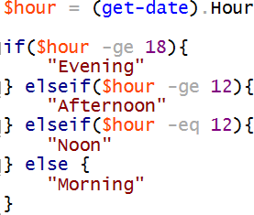
Conditional Statements
If/else
If/elseif/else

Slide 8
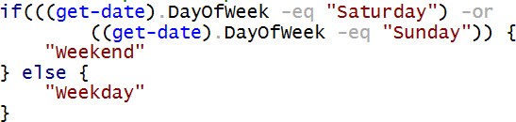
Combining Operators
Using parentheses to indicate precedence
(x –eq y) –and (y –eq z)

Slide 9


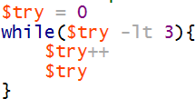
Loops
For
Foreach
While
Further loops: do..while loop, do..until loop
→ see Book ‘Windows PowerShell Cookbook, 3rd Edition’, Part II, Chapter 4 (see next slide for link)

Slide 10
Parsing Strings
$x = get-content <filename>
Variable contains the file content as array of lines
Lines can be accessed using index (zero-based)
– Line 6: $x[5]
Only line 2 and 6: $x[1,5]
Range of line 2 to 6: $x[1..5]
One liner for first 5 lines of file: (get-content <filename>)[0..4]
Select-string to match lines against strings (-SimpleMatch) or Regex patterns (-Pattern) along with various options
$x | select-string -SimpleMatch -CaseSensitive “PoWeRShell"
Returns MatchInfo object that has further properties (e.g. actual
content (.Line), line number (.LineNumber))
$x | select-string -SimpleMatch “PoWeRShell“ | get- member
Example returning the line number(s!) for a matching string
$x | select-string -SimpleMatch “PoWeRShell“ |
foreach-object {$_.LineNumber}
$x | select-string -SimpleMatch “PoWeRShell“ | select LineNumber
19

Slide 11
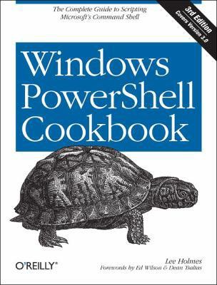
Lee Holmes: Windows PowerShell Cookbook, 3rd Edition, O'Reilly Media, Inc., 2013
URL:
http://proquestcombo.safaribooksonline.com/book
/-/9781449359195
Operating System Concepts
22

Slide 12
PowerShell Resources
Default Reference for PowerShell:
https://technet.microsoft.com/en- us/library/hh847741.aspx
Specific information about core modules
https://technet.microsoft.com/library/hh849695. aspx
Good blog for specific PowerShell tips
http://blogs.technet.com/b/heyscriptingguy/
Operating System Concepts
23

